Slide 1

Tables in CSS
BCAC 0019 Web Technology -1
Module 2
Dr. Kanta Prasad Sharma
Assistant Professor,
CEA, GLA University, Mathura

Slide 2
CSS Tables
The look of an HTML table can be greatly improved with CSS.
Table Borders
To specify table borders in CSS, use the border property.
The following example specifies a solid border for <table>, <th>, and <td> elements:
BCAC0016: Fundamentals of Internet Programming

Slide 3
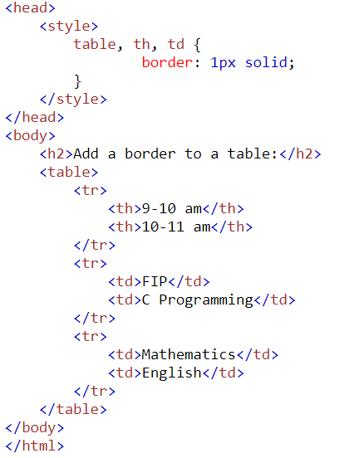
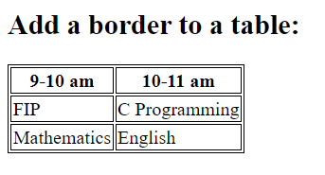
CSS Tables (Contd.)
OUTPUT:
BCAC0016: Fundamentals of Internet Programming

Slide 4
CSS Tables (Contd.)
The look of an HTML table can be greatly improved with CSS.
Full-Width Table
The table above might seem small in some cases. If you need a table that should span the entire screen (full-width), add width: 100% to the <table> element:
Example:
table { width: 100%; }
BCAC0016: Fundamentals of Internet Programming

Slide 5
CSS Tables (Contd.)
If you only want a border around the table, only specify the border property for <table>:
table { border: 1px solid; }
BCAC0016: Fundamentals of Internet Programming

Slide 6
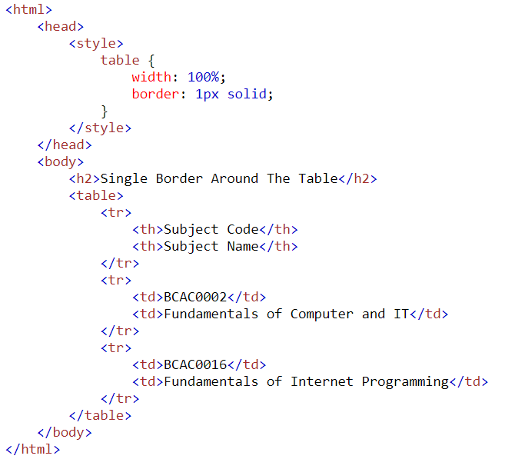
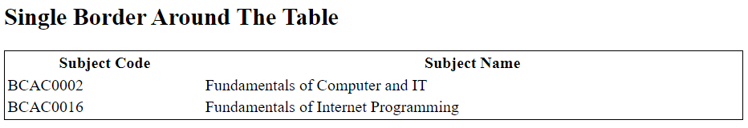
CSS Tables (Contd.)
OUTPUT:
BCAC0016: Fundamentals of Internet Programming

Slide 7
CSS Tables (Contd.)
Table Width and Height
The width and height of a table are defined by the width and height properties.
The example below sets the width of the table to 100%, and the height of the <th> elements to 70px:
Example:
table { width: 100%; } th { height: 70px; }
BCAC0016: Fundamentals of Internet Programming

Slide 8
CSS Tables (Contd.)
Horizontal Alignment
The text-align property sets the horizontal alignment (like left, right, or center) of the content in <th> or <td>.
By default, the content of <th> elements are center-aligned and the content of <td> elements are left-aligned.
To center-align the content of <td> elements as well, text-align: center:
td { text-align: center; }
BCAC0016: Fundamentals of Internet Programming

Slide 9
CSS Tables (Contd.)
Vertical Alignment
The vertical-align property sets the vertical alignment (like top, bottom, or middle) of the content in <th> or <td>.
By default, the vertical alignment of the content in a table is middle (for both <th> and <td> elements).
The following example sets the vertical text alignment to bottom for <td> elements:
td { height: 50px;
text-align: center; }
BCAC0016: Fundamentals of Internet Programming

Slide 10
CSS Tables (Contd.)
Table Padding
To control the space between the border and the content in a table, use the padding property on <td> and <th> elements:
th, td { padding: 15px;
text-align: left; }
BCAC0016: Fundamentals of Internet Programming

Slide 11
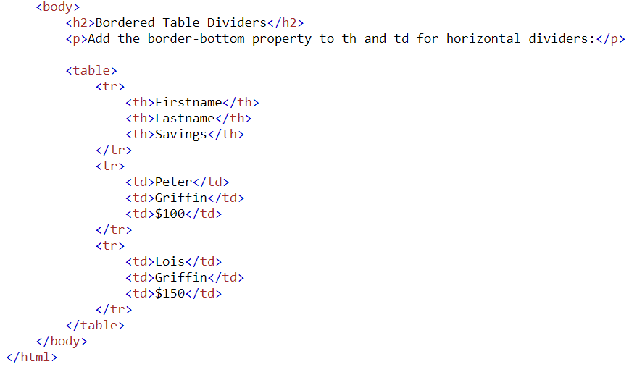
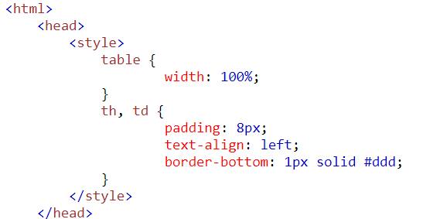
CSS Tables (Contd.)
Horizontal Dividers
Add the border-bottom property to <th> and <td> for horizontal dividers:
BCAC0016: Fundamentals of Internet Programming

Slide 12
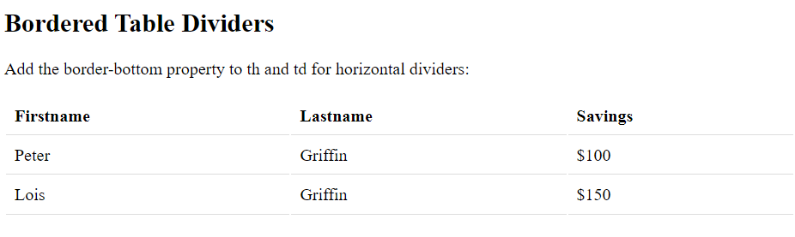
CSS Tables (Contd.)
OUTPUT:
BCAC0016: Fundamentals of Internet Programming

Slide 13
CSS Tables (Contd.)
Hoverable Table
Use the :hover selector on <tr> to highlight table rows on mouse over:
tr:hover { background-color: coral; }
BCAC0016: Fundamentals of Internet Programming

Slide 14
Thank You

